Slide 1

AT&T failure report
by Christopher Chamberlain
and
Sarah Narayamy Tavares Silva

Slide 2
Introduction
Information System Projects
“A planned undertaking of related activities to reach an objective that has a beginning and an end”
Project Management Institute
To take advantage of a business opportunity;
To solve a business problem
Notes:
Put some information about projects in general and how it works. also about project failures in general

Slide 3
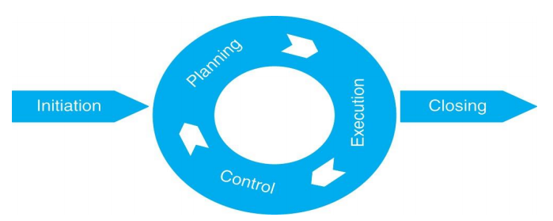
Introduction
Project Life Cycle
Initiation;
Planning;
Execution;
Controlling;
Closing.
Notes:
Initiate – potential projects are identified and evaluated in terms of importance to the organization • Plan – scope, time, cost and risk management planning takes place • Execute – project plan is followed • Control – project performance is measured against the project plan • Close – final paper work completed and sign off by all stakeholders

Slide 4
Introduction
Why projects fail
Lack of attention to human and organizational factors;
Poor project management;
Poor articulation of user requirements;
Inadequate attention to business needs and goals;
Failure to involve users appropriately
Notes:
Put some information about projects in general and how it works. also about project failures in general

Slide 5
Introduction
Why projects fail (continued)
Failed Communication;
Lack of Planning;
Poor Quality Control.
Notes:
Put some information about projects in general and how it works. also about project failures in general

Slide 6
About AT&T
AT&T is a worldwide company leader in communications, media and entertainment, and technology;
Company’s consolidated revenue was more than $160.5 billion in 2017;
Reputation built based on its reliability and security.
Notes:
Talk about AT&T as a company, their values at the time

Slide 7
1990 AT&T network outage
What happened
15th January 1990 at 2:25pm on Monday
Red warning signals from all the different parts of their world-wide network began to be noticed
Almost 50% of the calls placed through AT&T fail to go through.
Notes:
Talk about what happened at the time (general failure), like States were without communication during 9 hours
Incident on 15th january early evening
Warnings popped up from every connection
50% of calls start getting terminated

Slide 8
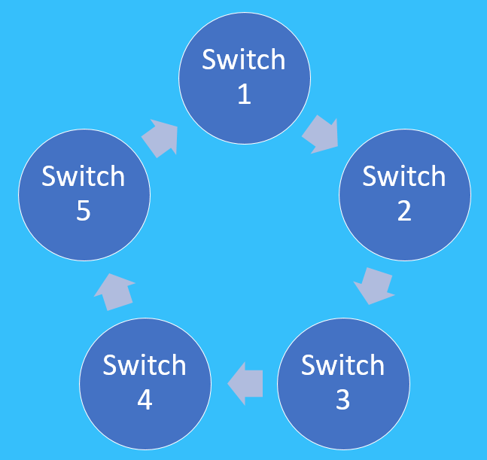
1990 AT&T network outage
How it happened
114 switches;
Constantly resetting;
Cascade;
On a loop;
New York;
Maintenance procedure.
Notes:
to understand what happened we need to understand how their system operated
talk about the AT&T system (114 switches)
First switch in the system came upon and error and sent a warning to the next switch then rebooted
Next switch sent a warning to the next in line and rebooted causing a cascade
All of New York affected
Maintenance had to be made for around 9 hours

Slide 9
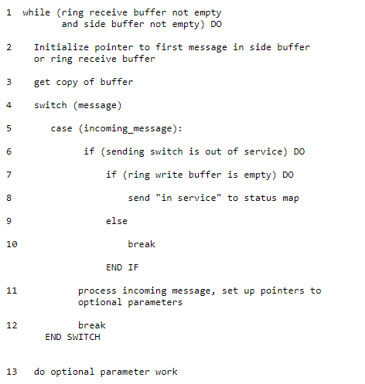
1990 AT&T network outage
How it happened (continued)
Time-delay;
Code entered break too soon;
Caused software to overwrite data;
Fail-safe reset the software in every switch.
(Burke, 1995)
Notes:
Amount of time to check for a response was too slow
Code entered a break too soon
The software overwrote data on the switch
Fail-safe noticed software being overwritten and quickly reset and rebooted to avoid the threat

Slide 10


1990 AT&T network outage
Costs of the failure
60 million dollars of lost revenue;
9 hours of service time;
75 million international missed phone calls;
1 Damaged reputation;
Notes:
estimated 60 million dollars lost
9 hours of calls put on standby due to maintenance
75 million international calls interrupted during the 9 hours
AT&T lost a lot of consumer trust

Slide 11

1990 AT&T network outage
Costs of the failure
Still unknown is the amount of business lost by airline reservations systems, hotels, rental car agencies and other businesses that relied on the telephone network.
Notes:
Many businesses that were using AT&T’s services suffered a heavy financial loss.
Hotels lose potential stays, Rental agencies lose renters

Slide 12
1990 AT&T network outage
Factors that might have caused the failure
Improperly tested software;
Poor project management;
Bad design process and software practices.
Notes:
Code not fully reviewed allows problems to enter implementation
Project management = bad team, unclear communication
Bad design process meaning Waterfall method instead of agile method

Slide 13

1990 AT&T network outage
How could it have been prevented
Sanity checks;
Investing more time and money into development and implementation.
Notes:
Review the program for any faults
Put rules in place to avoid bad practices when programming
Allow for a bigger budget

Slide 14
Conclusion
Importance of each phase within a project;
Importance of communication;
Every project is subject to failure;
Importance of Testing;
Analysis;
Use of a different type of program.
Notes:
Conclusion

Slide 15
Thank you
Questions
???

